Slide 1
Condition Monitoring Interval Optimisation using Failure Delay Time Concept
Darrell Leong
Zhang Meng

Slide 2
Scope
Failure delay time concept
RTAMO’s static methodology for condition monitoring interval optimisation
Proposed dynamic methodology for condition monitoring interval optimisation
Work outstanding

Slide 3
Failure Delay Time Concept
Failure process of asset is divided into two periods
Normal working period
Time length from new to the point asset is first identified to be faulty
Static condition monitoring interval optimisation
Failure delay time period
Time length from the point asset is first identified to be faulty to failure
If no maintenance intervention is performed
Dynamic condition monitoring interval optimisation using incoming information
Ref: Wang, 2003; Modelling condition monitoring intervals: a hybrid of simulation and analytical approaches

Slide 4
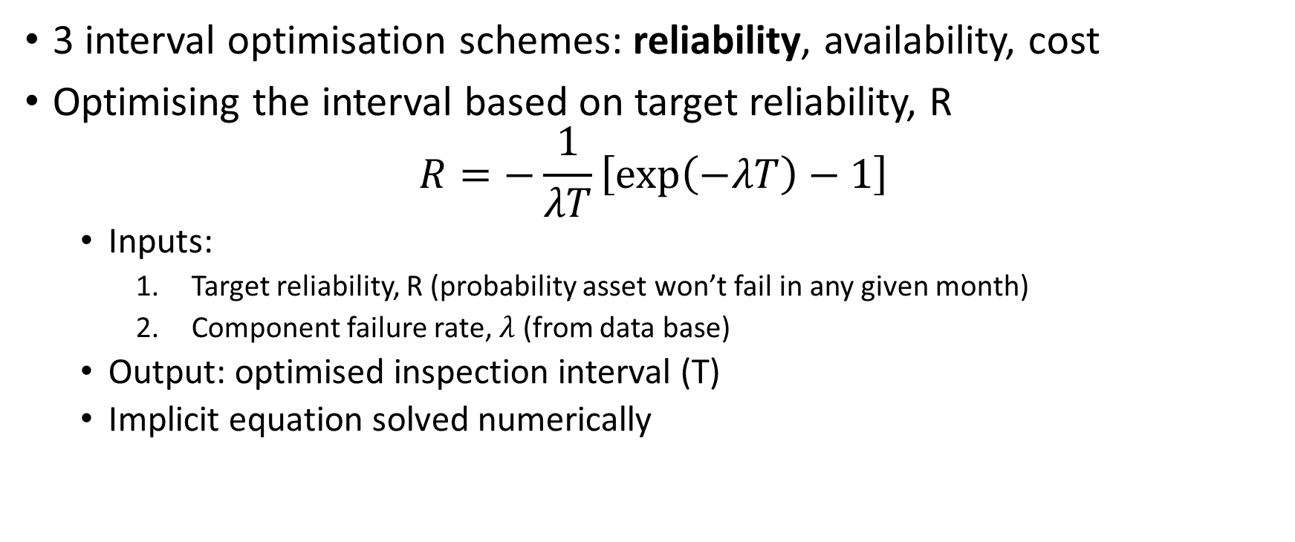
RTAMO: Static Interval Optimisation
3 interval optimisation schemes: reliability, availability, cost
Optimising the interval based on target reliability, R
$$R=−\frac{1}{λT}\left[exp\left(−λT\right)−1\right]$$
Inputs:
Target reliability, R (probability asset won’t fail in any given month)
Component failure rate, $λ$ (from data base)
Output: optimised inspection interval (T)
Implicit equation solved numerically

Slide 5
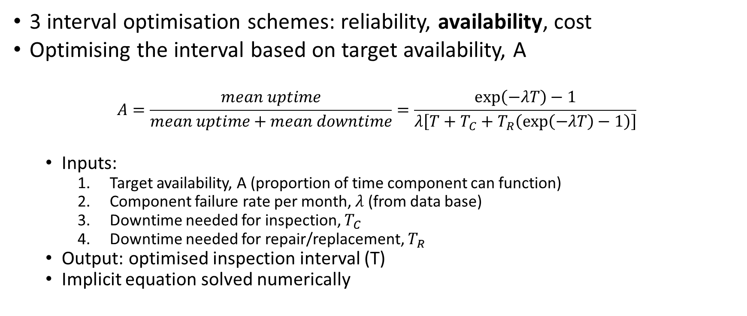
RTAMO: Static Interval Optimisation
3 interval optimisation schemes: reliability, availability, cost
Optimising the interval based on target availability, A
$$A=\frac{mean uptime}{mean uptime+mean downtime}=\frac{exp\left(−λT\right)−1}{λ\left[T+T_{C}+T_{R}\left(exp\left(−λT\right)−1\right)\right]}$$
Inputs:
Target availability, A (proportion of time component can function)
Component failure rate per month, $λ$ (from data base)
Downtime needed for inspection, $T_{C}$
Downtime needed for repair/replacement, $T_{R}$
Output: optimised inspection interval (T)
Implicit equation solved numerically

Slide 6
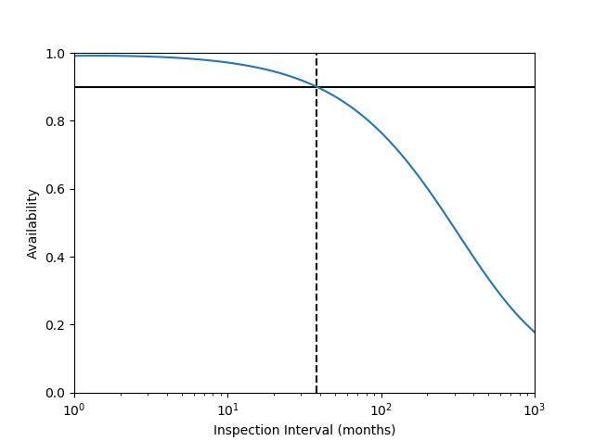
RTAMO: Static Interval Optimisation
Example from RTAMO verification:
Target availability = 0.9
Component failure rate = 0.0056
Inspection downtime = 4 hours
Repair downtime = 2 days
Optimised inspection interval:
38 months
Assumption: constant failure rate
Can an ageing asset be expected to have the same constant failure rate as a newly installed asset?

Slide 7
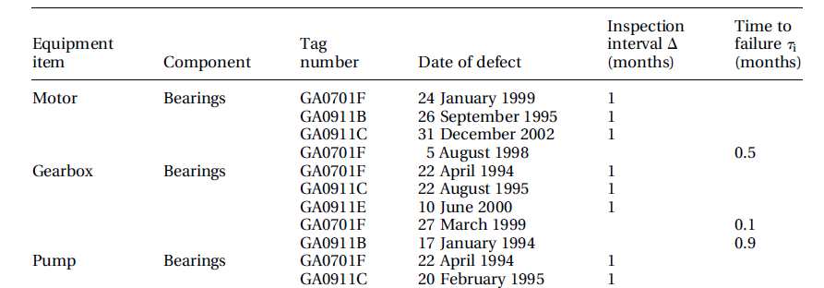
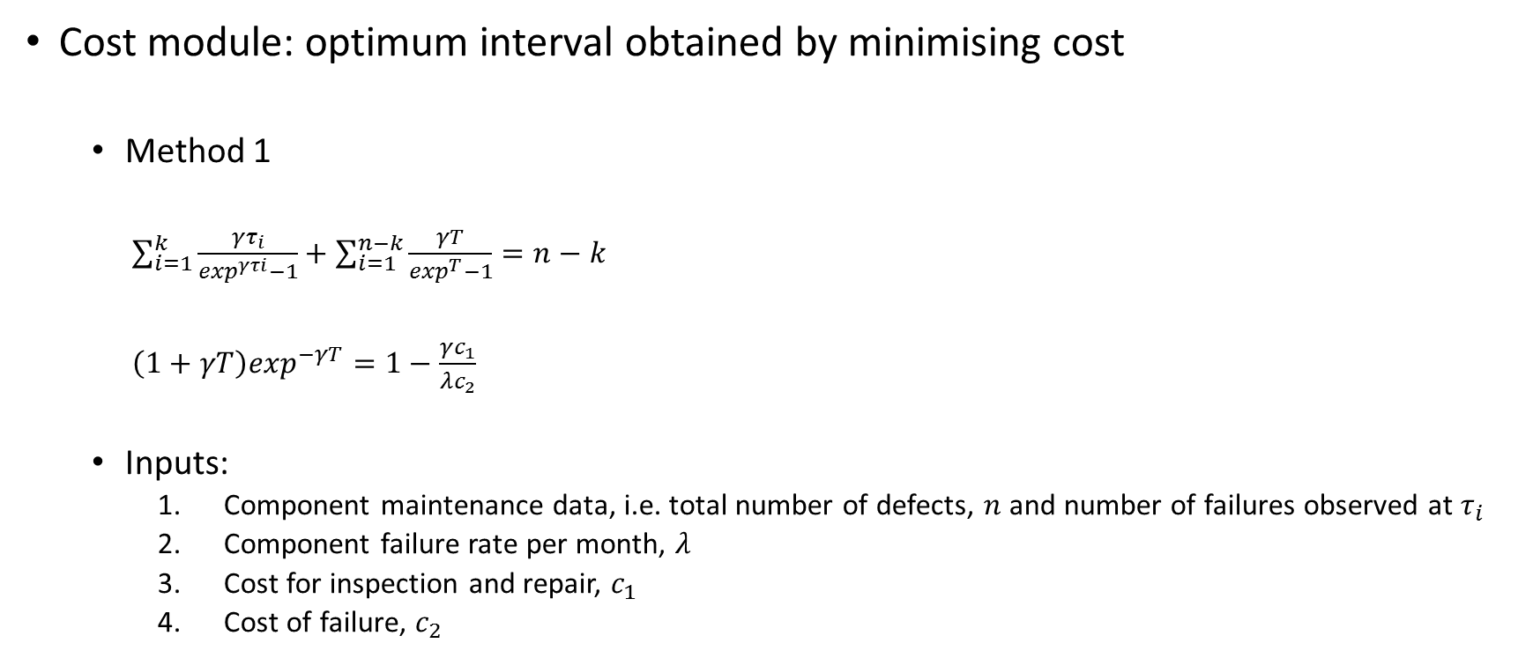
RTAMO: Static Interval Optimisation
Cost module: optimum interval obtained by minimising cost
Method 1
$\sum_{i=1}^{k}{\frac{γτ_{i}}{\exp^{γτi}−1}}+\sum_{i=1}^{n−k}{\frac{γT}{\exp^{T}−1}}=n−k$
$\left(1+γT\right)\exp^{−γT}=1−\frac{γc_{1}}{λc_{2}}$
Inputs:
Component maintenance data, i.e. total number of defects, $n$and number of failures observed at $τ_{i}$
Component failure rate per month, $λ$
Cost for inspection and repair, $c_{1}$
Cost of failure, $c_{2}$

Slide 8
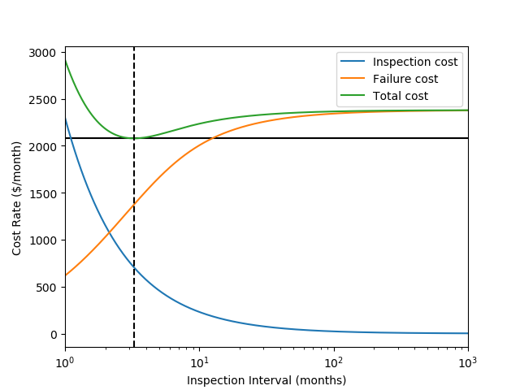

RTAMO: Static Interval Optimisation
Cost module: optimum interval obtained by minimising cost
Method 2
C$ost per time=\frac{c_{1}}{T}+λc_{2}(1−P_{D})$
$where (1−\exp^{−γT})/$ $γT$
Inputs:
Component failure rate per month, $λ$
Delay time, $γ$
Cost for inspection and repair, $c_{1}$
Cost of failure, $c_{2}$

Slide 9
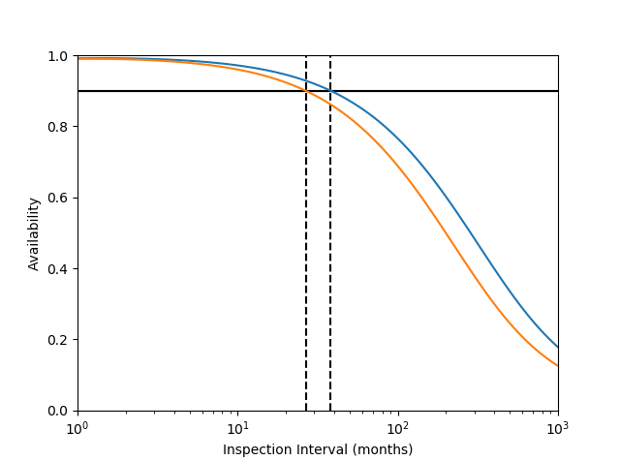
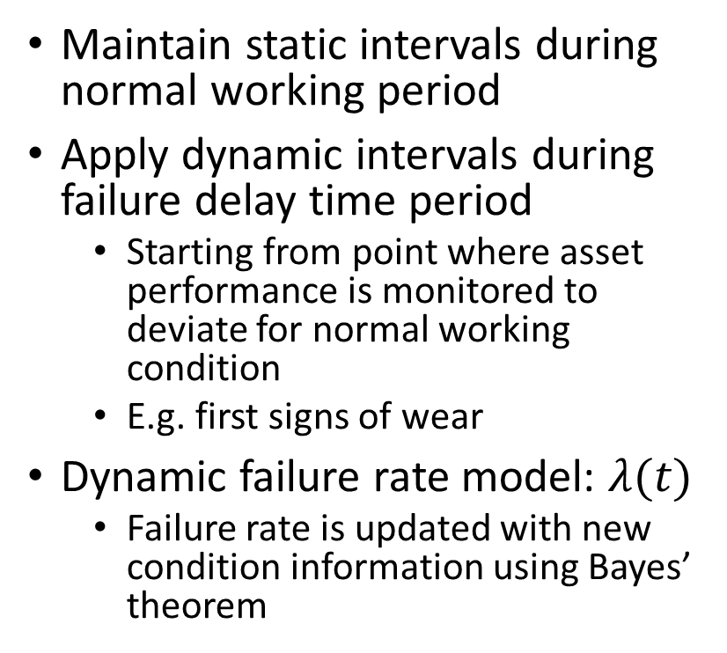
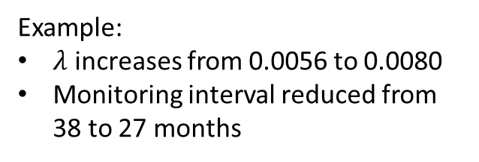
Dynamic Interval Optimisation - Availability
Maintain static intervals during normal working period
Apply dynamic intervals during failure delay time period
Starting from point where asset performance is monitored to deviate for normal working condition
E.g. first signs of wear
Dynamic failure rate model: $λ(t)$
Failure rate is updated with new condition information using Bayes’ theorem
Example:
$λ$ increases from 0.0056 to 0.0080
Monitoring interval reduced from 38 to 27 months

Slide 10
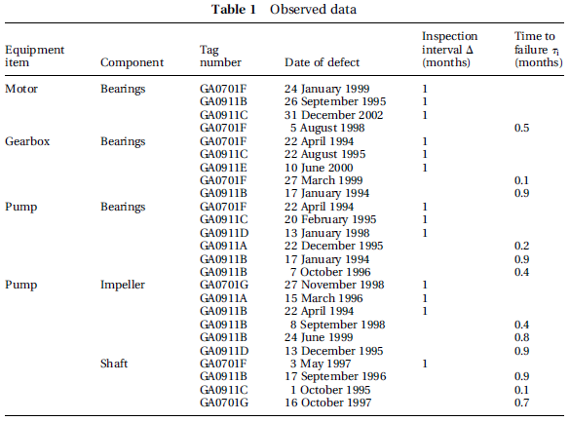
Dynamic Interval Optimisation - Cost
Maintain static intervals during normal working period
Apply dynamic intervals during failure delay time period
Starting from point when a single unit of component type fails
Update inspection table
Customised failure rates

Slide 11
Work Outstanding
Replication of RTAMO’s cost module
Review of how failure rates are dynamically updated in the failure delay time period

